Slide 1
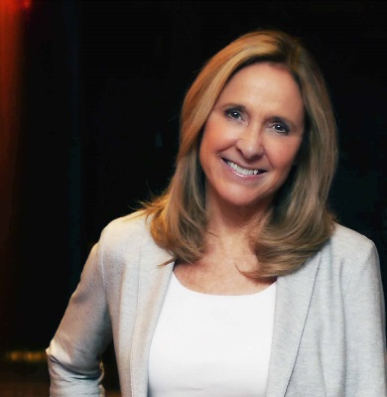
The Center for Translational Social Neuroscience
and
The Silvio O. Conte Center
Present:
THE SCIENCE OF LOVE SYMPOSIUM
A Public Seminar
Featuring:
Dr. Helen Fisher
The Kinsey Institute
and
Dr. Larry Young
Emory University
Join us for an enlightening evening discussing the latest scientific advances regarding our most powerful emotion
February 6, 2020 from 6:30-8:00PM
Drinks and light appetizers will be served at 6:00 PM
Claudia Nance Rollins Auditorium at the Rollins School of Public Health

